Slide 1
COM 213: PROCEDURAL PROGRAMMING II
BY: SAMWEL TARUS

Slide 2
PART 1: Introduction to Procedural Programming
Overview of modular programming language
Compilers used in C / C++ programming
Relationship between C and C++ programming languages

Slide 3
Overview of modular programming language (C Language)
Modular programming:
Software design technique that emphasizes separating the functionality of a program into independent, interchangeable modules, such that each contains everything necessary to execute only one aspect of the desired functionality.

Slide 4
Compilers used in C / C++ programming
Borland C++ ...
Dev C++
Turbo C / C++
Code block.
Embarcadero C++ builder. ...
Clang
Visual C++ ...
Intel C++ ...

Slide 5
Popular Java IDE
Eclipse. Platform – Linux/macOS/Solaris/Windows. ...
NetBeans. Platform – Linux/macOS/Solaris/Windows. ...
IntelliJ IDEA. Platform – Linux/macOS/Windows. ...
BlueJ. Platform – Linux/macOS/Windows. ...
(Oracle) JDeveloper. Platform – Linux/macOS/Windows. ...
DrJava. Platform – Linux/macOS/Windows. ...
JCreator. ...
https://hackr.io/blog/best-java-ides

Slide 6
Relationship b/w C and C++ programming languages
C
Modular PL
Syntax similar
Application area: System Programming
Execution: Compile and run
Platform Dependent
.C
C++
Supports OOP
Syntax similar
Application area: system Programming
Execution: Compile and run
Platform Dependent
.CPP
JAVA
Pure OOP
Syntax similar
Application area: Application Programming, Internet apps
Execution: Compile/ Intepretor and run
Platform Independent
.Java

Slide 7
Part II: Introduction to object oriented programming concepts
Software Crisis, Software Evolution.
Procedural programming Paradigm.
Object oriented approach introduced, examples of OOP languages
Characteristics of object oriented languages
Benefits of object oriented programming languages
Applications of OOP

Slide 8
Software Crisis
Software Technology dynamics
Issues to be addressed to mitigate s/w crisis:
How to design systems with open interfaces
How to represent real life entities of problems in systems.
How to ensure re-usability and extensibility of modules
How to improve quality of software
How to manage time schedules.
How to improve s/w productivity and decrease s/w cost.

Slide 9
Causes of the software crisis
Projects running over-budget
Projects running over-time
Software was inefficient.
Software was of low quality
Software often did not meet requirements
Software was not delivered.
Projects were unmanageable
Difficulty in maintaining the code.

Slide 10
Quality issues to be considered for critical evaluation
S/w products should be evaluated for quality b4 they are delivered and implemented.
Correctness.
Maintainability.
Reusability.
Openness and interoperability.
Portability.
Security.
User-friendliness

Slide 11
SOFTWARE EVOLUTION
The process of developing, maintaining, then timely updating software for various reasons. i.e., to add new features or to remove obsolete functionalities etc.
It includes the initial development of software, its maintenance and updates, till desired software product is developed, which satisfies the expected requirements.
Nb: Software changes are inevitable because there are many factors that change during the life cycle of a piece of software. Some of these factors include:
Requirement changes
Environment changes
Errors or security breaches
New equipment added or removed
Improvements to the system

Slide 12
Importance of Software Evolution
Change in requirement with time: Organization’s needs and working changes substantially over time which calls for a corresponding change in the software.
Environment change: Environmental dynamics calls for working environment changes hence old software must be updated with new features and functionality to adapt the new environment.
Errors and bugs: Obsolete Software need to undergo the evolution process in order to become robust as per the workload complexity of the current environment.
Security risks: To eliminate security threats such as cyberattacks and make software more robust.
For having new functionality and features: To increase the performance and fast data processing and other functionalities.

Slide 13
Procedural programming paradigm
Modular programming: Software design technique that emphasizes separating the functionality of a program into independent, interchangeable modules, such that each contains everything necessary to execute only one aspect of the desired functionality
Generally, functions fall into two categories:
Program Control – Functions used to simply sub-divide and control the program. These functions are unique to the program being written. Other programs may use similar functions, maybe even functions with the same name, but the content of the functions are almost always very different.
Specific Task – Functions designed to be used with several programs. These functions perform a specific task and thus are usable in many different programs because the other programs also need to do the specific task. Specific task functions are sometimes referred to as building blocks. Because they are already coded and tested, we can use them with confidence to more efficiently write a large program

Slide 14
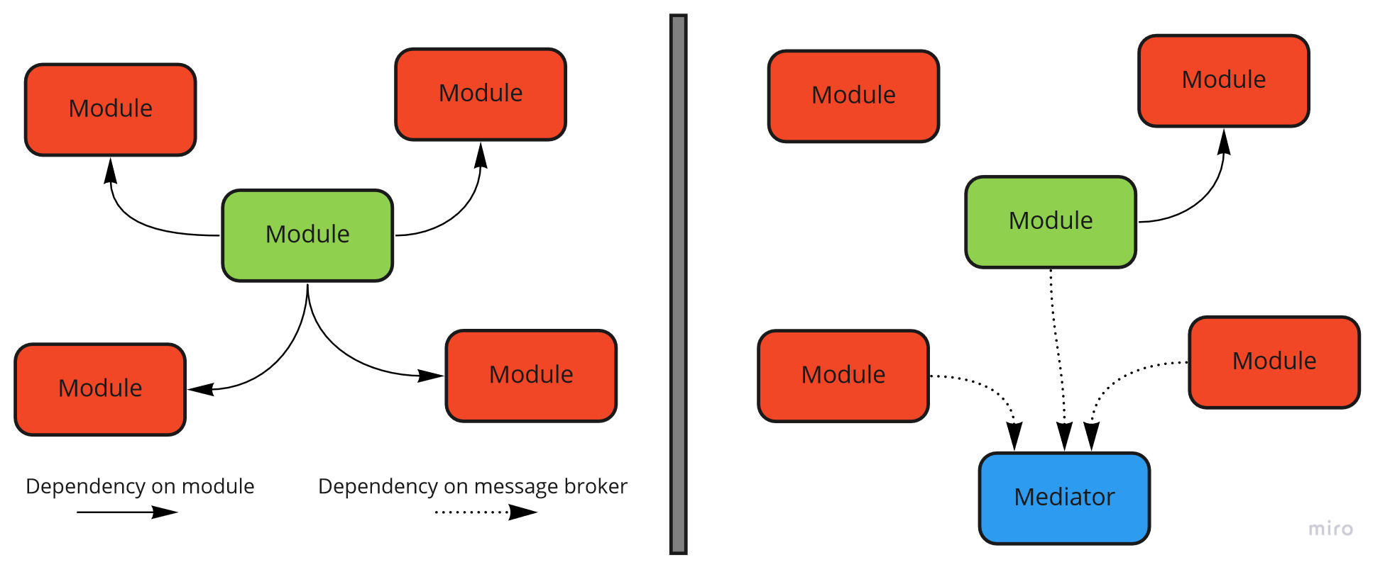
Modular Programming

Slide 15
Properties of Procedural programming Paradigm
Emphasis is on doing things (algorithm)
Large programs are divided into smaller programs called functions.
Most of the functions share global data.
Data move openly around the system from function to function.
Functions transform data from one form to another.
Employs top-down approach in program design.

Slide 16
Introduction to Object oriented approach
OOP:
Programming paradigm based on dividing the program into objects.
Concepts of OOP:
Class
Object
Data Abstraction and Encapsulation
Inheritance
Polymorphism
Dynamic binding
Message passing

Slide 17
Characteristics of object oriented languages
Objects:
Objects are basic building blocks for designing programs.
An object is a collection of data members and associated member functions.
An object may represent a person, place or a table of data.
Each object is identified by a unique name. Each object must be a member of a particular class.
Example: chair, table, whiteboard are the objects of the class (class).
https://tutorialslink.com/Articles/Basic-Characteristics-of-Oops/1308

Slide 18
Classes:-
The objects can be made user-defined data types with the help of a class.
A class is a collection of objects that have identical properties, common behavior and shared relationship.
Once the class is defined any number of objects of that class is created.
User-defined data types. A class can hold both data and functions.
For example planets, sun and moon are the members of the solar system class.
Data abstraction:-
Refers to the process of representing essential features without including background details or explanations.
Data encapsulation:-
The wrapping of data and function into a single unit
Enables data hiding and information hiding.

Slide 19
Inheritance:-
The process by which one object can acquire and the use of properties of another object.
The existing class is known as a base class or superclass.
The new class is known as a derived class or subclass.
The derived class shares some of the properties of the base class. Therefore a code from a base class can be reused by a derived class.
Polymorphism:-
The ability of an operator and function to take.
Multiple forms are known as polymorphism.
The different types of polymorphism are operator
overloading and function overloading.

Slide 20
Benefits of object oriented programming languages
Code Re-useability
Effective problem solving.
Reduced Maintenance: The primary goal of object-oriented development is the assurance that the system will enjoy a longer life while having far smaller maintenance costs. Because most of the processes within the system are encapsulated, the behaviors may be reused and incorporated into new behaviors.
Real-World Modeling: Object-oriented systems tend to model the real world in a more complete fashion than do traditional methods. Objects are organized into classes of objects, and objects are associated with behaviors. The model is based on objects, rather than on data and processing.
Improved Reliability and Flexibility: Object-oriented system promise to be far more reliable than traditional systems, primarily because new behaviors can be "built" from existing objects. Because objects can be dynamically called and accessed, new objects may be created at any time. The new objects may inherit data attributes from one, or many other objects. Behaviors may be inherited from super-classes, and novel behaviors may be added without effecting existing systems functions.

Slide 21
Examples of OOP languages
Java, C++, C#, Python, R, PHP, Visual Basic.NET, JavaScript, Ruby, Perl, Object Pascal, Objective-C, Dart, Swift, Scala, Kotlin, Common Lisp, MATLAB, and Smalltalk.

Slide 22
Applications of OOP
Rael Time Systems
Simulation and Modelling
Object Oriented databases
AI and Expert systems.
Neural networks and Parallel programming
Decision support and office automation systems.
Client server systems

